Slide 1


Assignment on Git
Presented By: Chiranjeev kumar
Notes:
Note: First “Right Click” on the Gradient background, go to “Order” option and “Send it to Back”, then insert your picture into “Image Placeholder”, “Right Click” on the picture and again go to “Order” option and “Send it to Back” to get the “Gradient” effect.

Slide 2
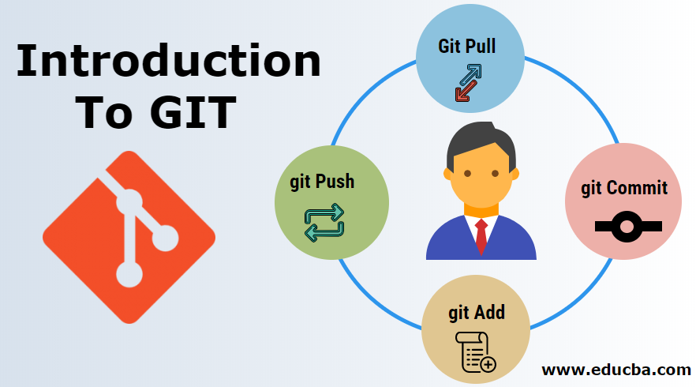
Git is an open source distributed version control system
Features of Git –
Compatibility
Non-linea Development
Branching
Lightweight
Speed
Open-Source
Reliable
Secure
…

Slide 3

Our Agenda
01
Creating repository
02
Commit
03
Configurations from local to global
04
Git reset

Slide 4
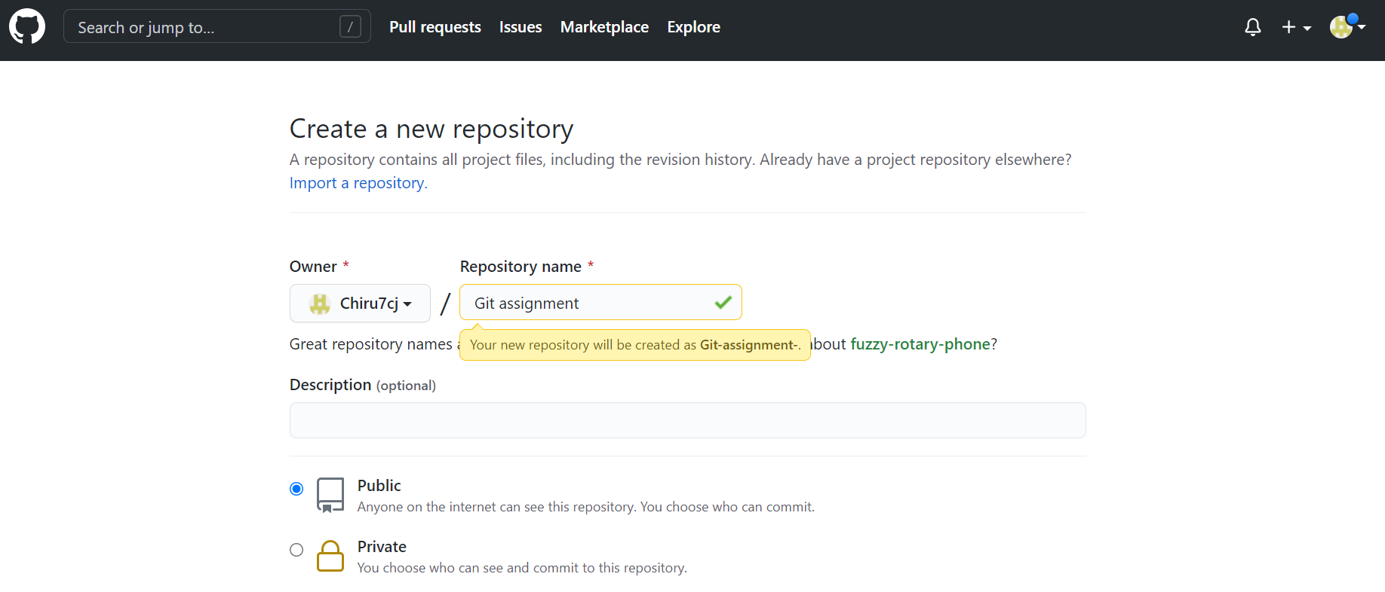
Creating repository
First login to your github account https://github.com/
And create new repository

Slide 5
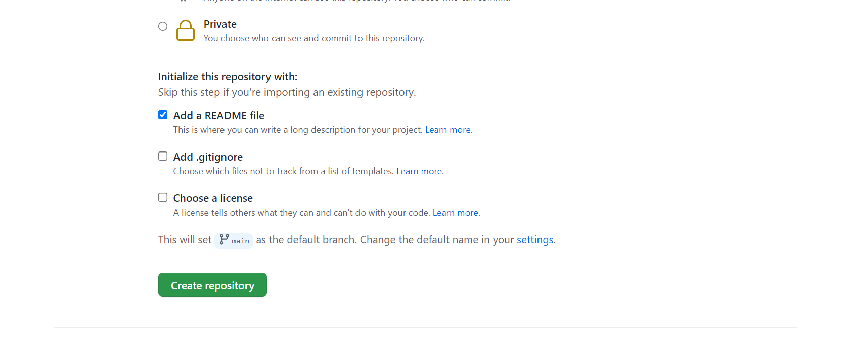
Creating repository
Click on create respository

Slide 6
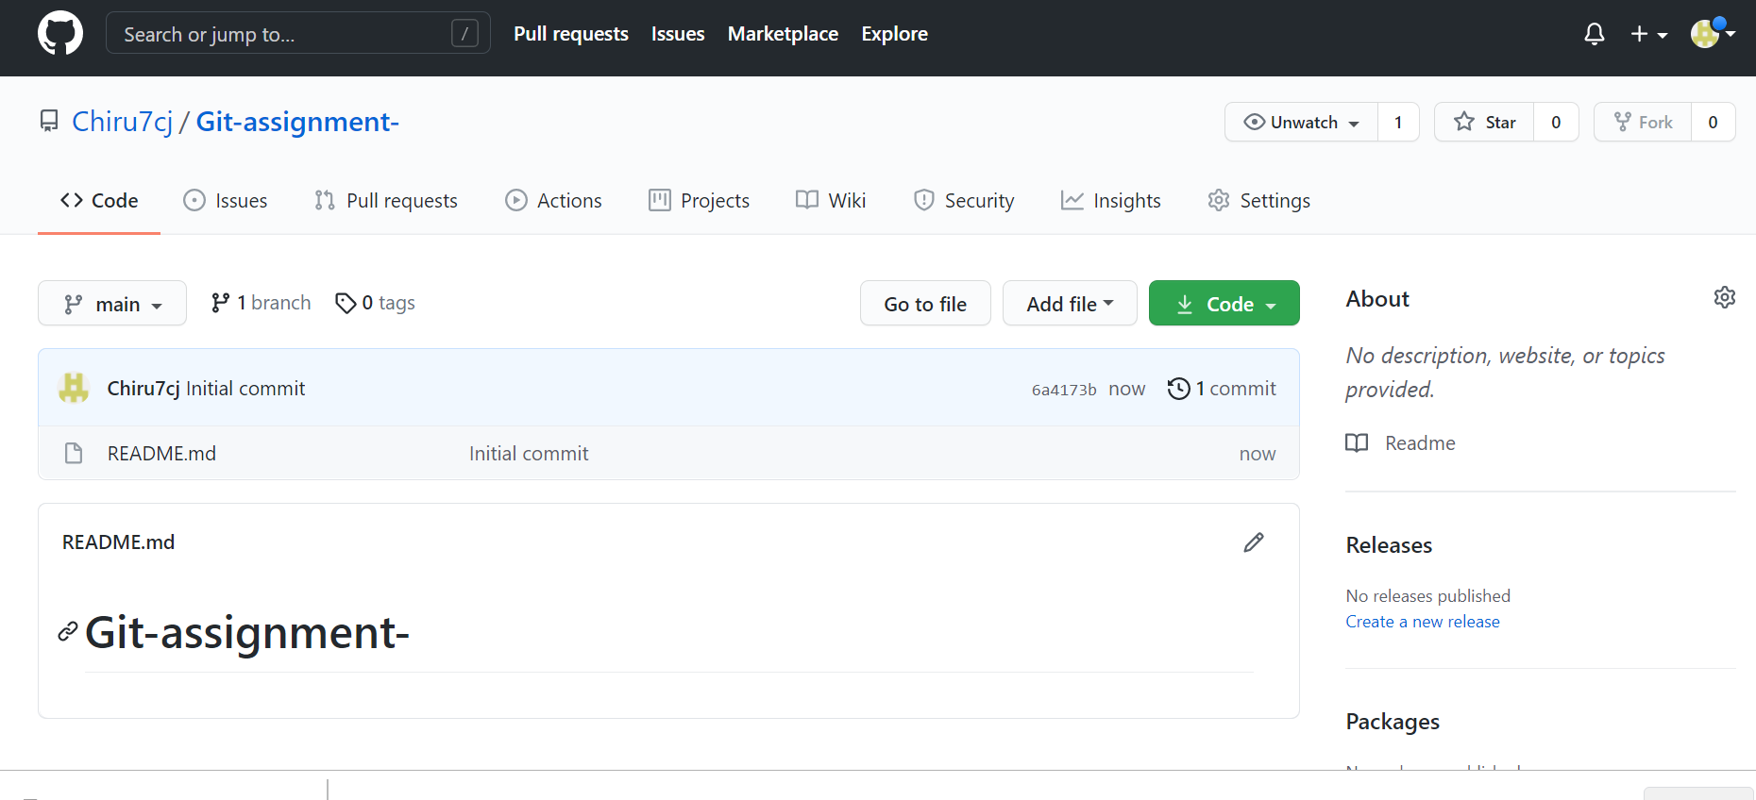
Creating repository
Respository has been created
https://github.com/Chiru7cj/Git-assignment-.git

Slide 7
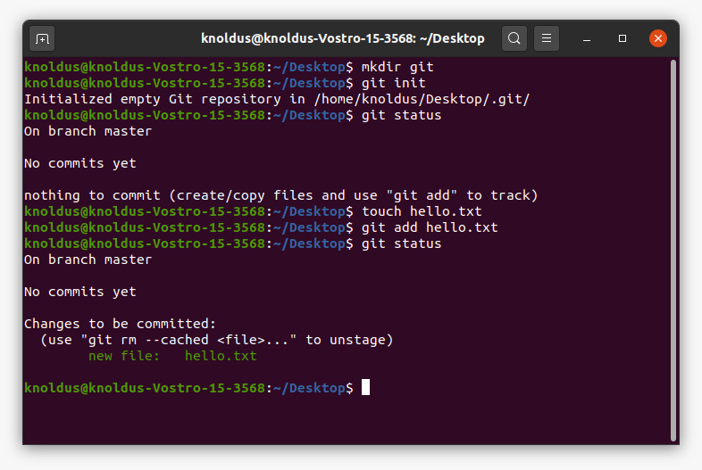
Creating repository
Now create a local repository

Slide 8
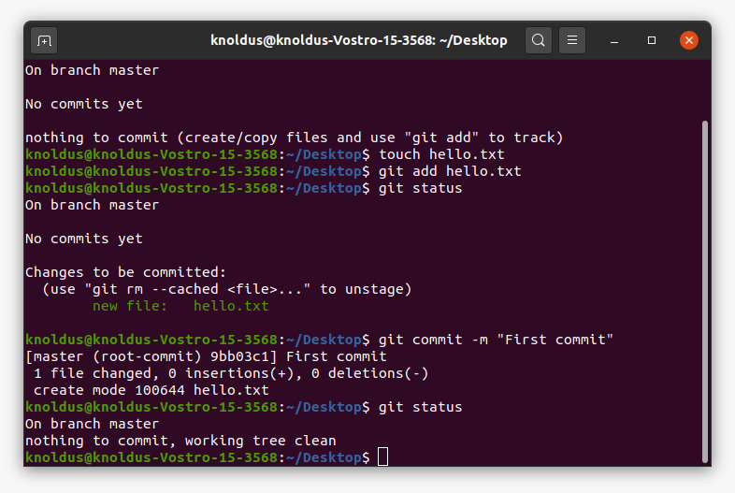
Commit

Slide 9
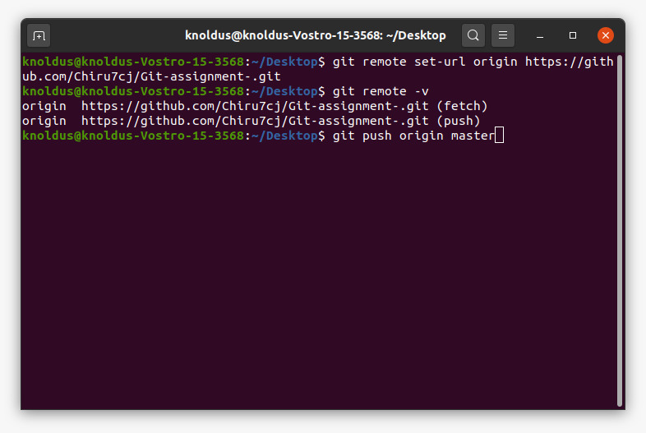
Configuration from local to global

Slide 10
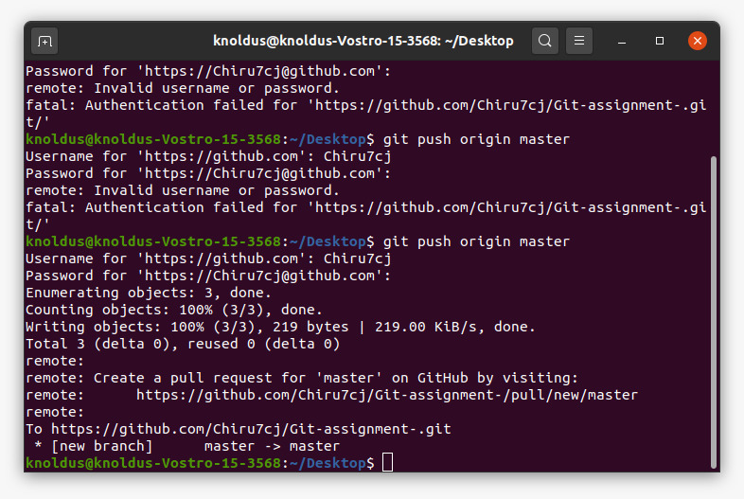
Configuration from local to global

Slide 11
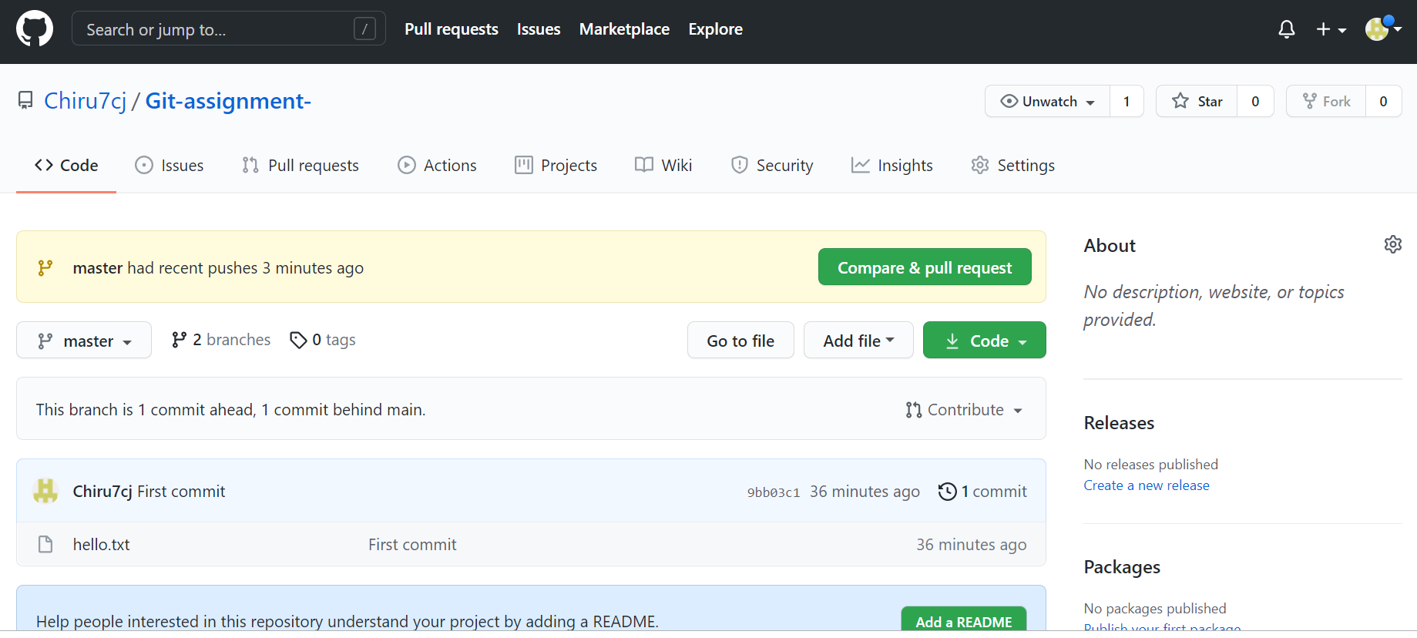
Configuration from local to global changes reflection at global repository

Slide 12

Git Reset The git reset command is a complex and versatile tool for undoing changes. It has three primary forms of invocation. These forms correspond to command line arguments --soft, --mixed, --hard

Slide 13
Git Reset and three trees of git To properly understand git reset usage, We must first understand Git's internal state management systems. Sometimes these mechanisms are called Git's "three trees". Trees may be a misnomer, as they are not strictly traditional tree data-structures. They are, however, node and pointer-based data structures that Git uses to track a timeline of edits. The best way to demonstrate these mechanisms is to create a changeset in a repository and follow it through the three trees.

Slide 14
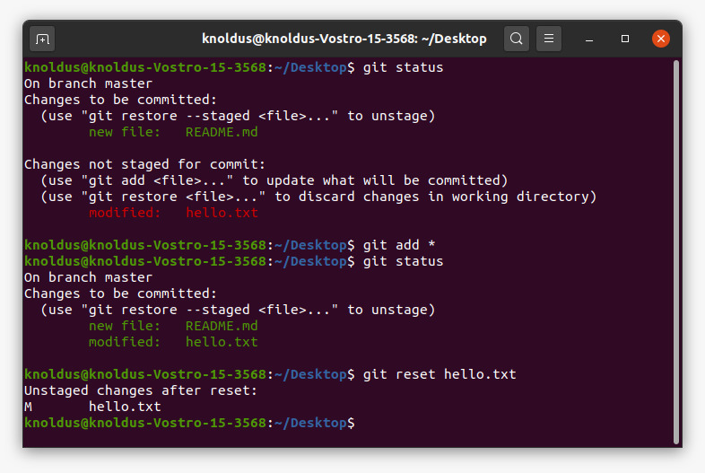
Git Reset Example

Slide 15
Some usefull commands git init git clone git log git diff git status git add git commit git checkpoint

Slide 16
Thank You !

